Slide 1
Chapter 1 Objectives
The CCNA Topics Covered in this chapter include:
  Why Access lists
  What are access lists
  Types of access lists

Slide 2
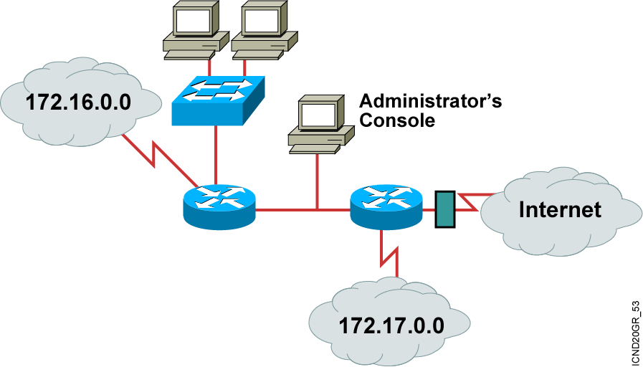
Why Use Access Lists?
  Manage IP traffic as network access grows
  Filter packets as they pass through the router

Slide 3
What are ACLs?
ACLs are lists of conditions that are applied to traffic traveling across a router's interface.
These lists tell the router what types of packets to accept or deny.
Acceptance and denial can be based on specified conditions.
ACLs can be configured at the router to control access to a network or subnet.
Some ACL decision points are source and destination addresses, protocols, and upper-layer port numbers.

Slide 4
Types of Access Lists
Standard Access List
  Filter by source IP addresses only
Extended Access List
  Filter by Source IP, Destination IP, Protocol Field, Port Number
Named Access List
  Functionally the same as standard and extended access lists.

Slide 5
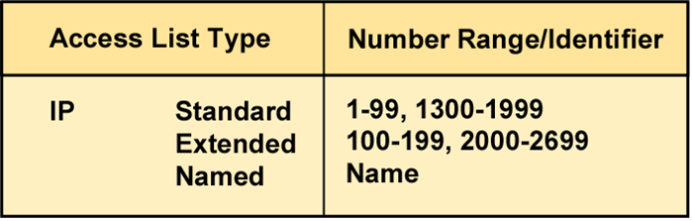
How to Identify Access Lists
  Standard IP lists (1-99) test conditions of all IP packets from
  source addresses.
  Extended IP lists (100-199) test conditions of source and destination addresses, specific TCP/IP protocols, and destination ports.
  Standard IP lists (1300-1999) (expanded range).
  Extended IP lists (2000-2699) (expanded range).

Slide 6
Application of Access Lists
Inbound Access Lists
  Packets are processed before being routed to the outbound interface
Outbound Access Lists
  Packets are routed to the outbound interface & then processed through the access list

Slide 7
ACL Configuration Guidelines
One access list per interface, per protocol, or per direction
More specific tests at the top of the ACL
New lists are placed at the bottom of the ACL
Individual lines cannot be removed
There is an implicit deny statement at the end of every ACL. Every ACL needs at least one permit statement
Create ACLs & then apply them to an interface
ACLs do not filter traffic originated from the router
Put Standard ACLs close to the destination
Put Extended ACLs close to the source

